Slide 1
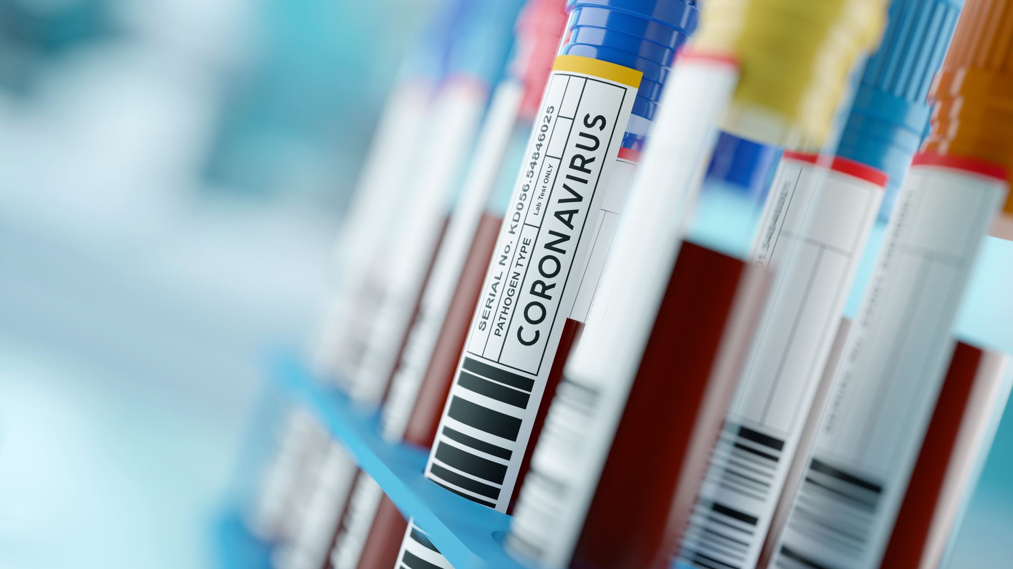
Analysis of Coronavirus related tweets
By Ryan Johnson & Andy Halsey

Slide 2
Goals
This project will analyze a subset of tweets from a larger dataset, that has multiple factors, which can make this data useful for demonstrating trends, which businesses could use for more effective marketing.
Throughout this project we will be creating various models to analyze the contents of the tweets in the dataset, and using those contents to predict whether the tweet expresses an extremely positive, positive, neutral, negative or extremely negative outlook.

Slide 3
Why Analyze Tweets?
Analysis of tweets at a large scale can show general public sentiment towards a topic, with this we can gage whether most people were expressing negative or positive opinions near the start of Covid 19, which is when the data was gathered.
This data can be used by companies or governments to determine how best to approach public policy or advertising.

Slide 4
Overview
This dataset has many factors that it logs with each tweet that can be analyzed to extrapolate broader trends:
Location – where the tweet poster was from
TweetAt – Time that the tweet was posted
OriginalTweet – The text of the tweet
Sentiment – The views expressed in the tweet, with five potential values: extremely negative, negative, neutral, positive and, extremely positive

Slide 5
Methodology and preprocessing
First, we merged the location, tweetAt and original tweet columns into tweet_texts to make data analysis easier.
After that, we used regular expressions to remove characters from the texts of the tweets to make analysis easier, as well as doing named entity recognition on the texts to identify key features for the analysis, saving a lot of time.
Lastly, we extracted the tokens from the texts and the lemmas and replaced the tweet_texts column with the extracted lemmas to allow the upcoming models to better process the data.

Slide 6
Visualizing Sentiment

Slide 7
Visualizing the length of the data

Slide 8
Visualizing the word counts of the data

Slide 9
Top 10 unigrams and bigrams in the data

Slide 10
Using scattertext to visualize the top 10 most frequent terms

Slide 11
Using scattertext to visualize top 10 tokens associated with positive sentiment

Slide 12

Using models to forecast sentiment
This next section will be using three different models to forecast sentiment values given tweet_texts

Slide 13
First model – Random forest model
We used a Random forest model as our first model to predict sentiment, it was not very good at predicting sentiment and it tended to over predict positive sentiment, with an overall accuracy of 38%

Slide 14
Second model – Random Forest model with gridsearch
We used another Random forest model as our second model to predict sentiment, utilizing gridsearch to tune the model’s parameters, slightly improving it but not by much, the accuracy was 39% this time.

Slide 15
Third model – Tuning for hyperparameters with 3 models
We took a different approach to the last model, using 3 different classifiers tuned for hyperparameters, and using the best one out of them all, which turned out to be the ___ model with an accuracy of ___%.

Slide 16
First topic model

Slide 17
Second topic model

Slide 18
Second topic model visualized

Slide 19
Takeaways
What information does this analysis give us

Slide 20
Utility
This project demonstrates the viability of text-mining in being used for large scale opinion assessment and prediction
This would be an incredibly useful service for a company, politician or anyone trying to assess broader public interest in an idea related to coronavirus.

Slide 21
Uncertainties and limitations
Given the broad nature of some of the locations, narrowing this data down to give specific regional analysis of public opinion would not yield very specific results, maybe if locations were more specific this would be better for that, but as it is, it is only good for broadly assessing trends.
Additionally, the short window of time data was gathered in gives us a very narrow view, perhaps if the tweets were gathered over the course of a year, we could get more insightful results about how public opinion adapts over time.

Slide 22

Recommendations to businesses
The data extracted here would be incredibly useful in many ways for a company attempting to market something during the early weeks of covid, one example would be through the topic models, where an organization could look at which words were most frequent in the grouping of positive sentiments and then latch similar words onto promotional messaging for their products.

Slide 23
Sensitivity of models
The models tended to vary heavily depending on how much data they were given; with more data they became much more accurate but with little data they tended to significantly over predict positive sentiment.

Slide 24
Questions?

Slide 25
Conclusion
This project offers valuable insight into how text mining skills can be utilized in real world situations for assessing public opinion on broad topics.

